Slide 1
WP3 – General Overview
Prof. Dr. W.J.A.M. Van Den Heuvel
Dr. D. A. Tamburri

Slide 2
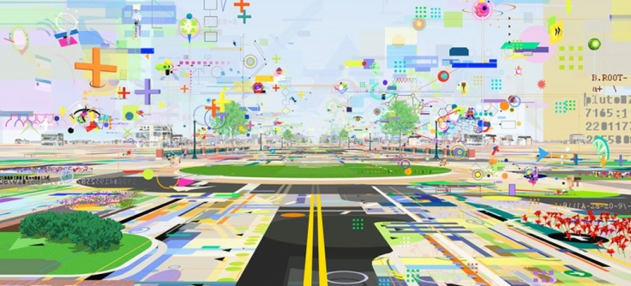
Objectives
Description of best practices and technologies for the protection of urban areas;
Bringing innovative solutions (EU-based) originated from EU research projects in the security domain;
Provide a technology roadmap for the protection of soft targets in EU cities;

Slide 3
WP Outline
WP3 represents the technology related part of the PRoTECT project. The consortium will make extensive usage of previous efforts in the protection of public spaces and previous work from the ENLETS network and EFUS members. Research results from previous H2020 projects and with high TRL level (6 and above) will be assessed as part of our technology evaluation framework; promising research solutions will be selected for a demonstration set up in the 5 city partners. To do so, the evaluation framework will be defined systematically by the entire consortium and communicated and assessed by the 5 target cities. At the end, WP3 will provide a technology roadmap to be used as a handbook by an extended numbers of EU municipalities via the EFUS Association.

Slide 4
Tasks Outline
[JADS] - 3.1 : Description of Best practices and Technologies from the state of the art;
[TNO] - 3.2 : Technology Evaluation framework - parameters and factors to be used for evaluation and decision-making of future technologies, also in connection with available field labs in public spaces in the beneficiary 5 cities;
[KEMEA] - 3.3 : Open calls for security and assessment;
[JADS] – 3.4 : Definition of Technology roadmap - technology challenges roadmap, possibly providing datasets (within limits of privacy, security and data management issues), and specific future research questions;

Slide 5

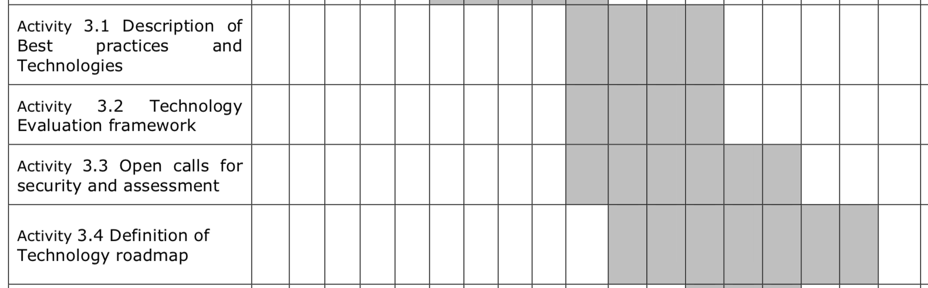
Workplan

Slide 6
Logical Flow (IOHO)
Vulnerability Assessment + WS’ (WP2,3)
Cities Application Scenarios Assessment (WP3)
List of Vulnerabilities from Assessment (WP3)
Tool-Selection + Framework + Open-Call (WP3)
Demo (WP4)

Slide 7
Tasks Outline
3.1 Description of Best practices and Technologies from the state of the art;
3.2 Technology Evaluation framework - parameters and factors to be used for evaluation and decision-making of future technologies, also in connection with available field labs in public spaces in the beneficiary 5 cities;
3.3 Open calls for security and assessment;
Definition of Technology roadmap - technology challenges roadmap, possibly providing datasets (within limits of privacy, security and data management issues), and specific future research questions;
Result: State of the Art in «Urban Intelligence»
Tentative: Augmented-Reality prototype for PRoTECT targets
JADS (3.5 PM), IGPR (3 PM), TNO (3 PM), DITSS (1 PM), L3CE (2 PM)

Slide 8
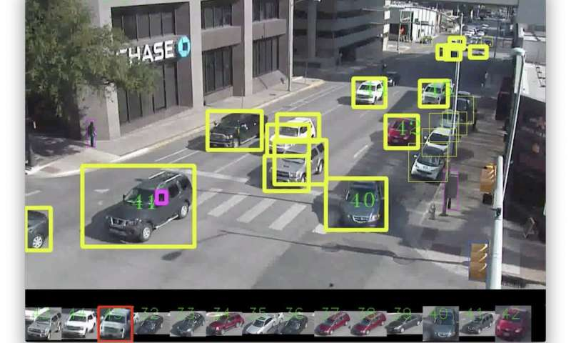

Slide 9


Slide 10
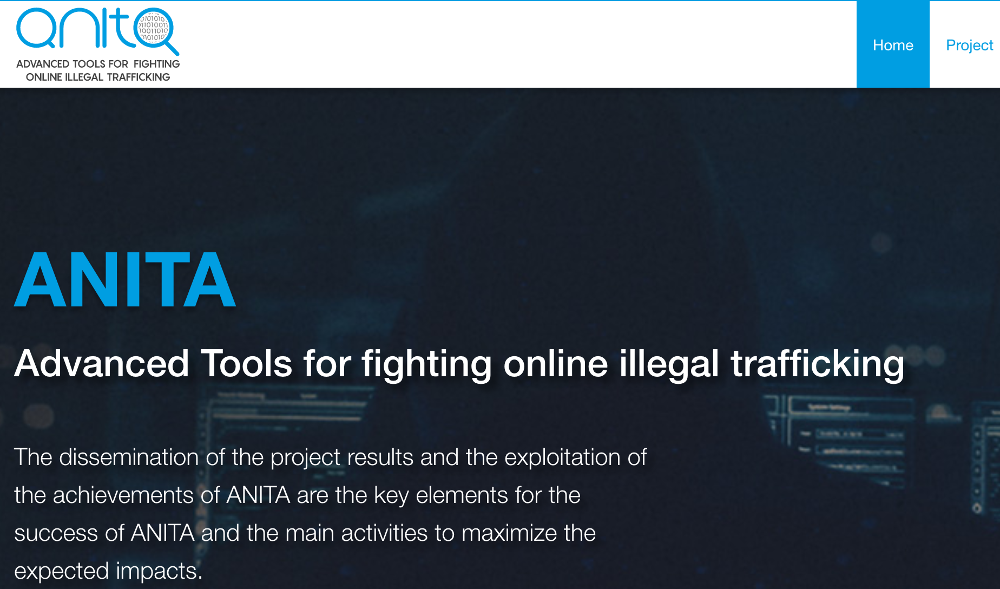

Slide 11
Tasks Outline
3.1 Description of Best practices and Technologies from the state of the art;
3.2 Technology Evaluation framework - parameters and factors to be used for evaluation and decision-making of future technologies, also in connection with available field labs in public spaces in the beneficiary 5 cities;
3.3 Open calls for security and assessment;
Definition of Technology roadmap - technology challenges roadmap, possibly providing datasets (within limits of privacy, security and data management issues), and specific future research questions;
How ➔ Systematic Multivocal Literature Review;
Expected Duration ➔ 1-3 Months;

Slide 12
Tasks Outline
3.1 Description of Best practices and Technologies from the state of the art;
3.2 Technology Evaluation framework - parameters and factors to be used for evaluation and decision-making of future technologies, also in connection with available field labs in public spaces in the beneficiary 5 cities;
3.3 Open calls for security and assessment;
Definition of Technology roadmap - technology challenges roadmap, possibly providing datasets (within limits of privacy, security and data management issues), and specific future research questions;
Result: Conceptual Model / Ontology;
Tentative: Assistive Assesment & Selection Tech, ML + Aug.Rel.;
KEMEA (2 PM), TNO (3 PM), EINDHOVEN, MALAGA, LARISA, VILNIAUS, BRASOV (each 1 PM)

Slide 13
Tasks Outline
3.1 Description of Best practices and Technologies from the state of the art;
3.2 Technology Evaluation framework - parameters and factors to be used for evaluation and decision-making of future technologies, also in connection with available field labs in public spaces in the beneficiary 5 cities;
3.3 Open calls for security and assessment;
Definition of Technology roadmap - technology challenges roadmap, possibly providing datasets (within limits of privacy, security and data management issues), and specific future research questions;
How ➔ Ontology Engineering / FCA / Empirical Research;
Expected Duration ➔ 1-3 Months;

Slide 14
Tasks Outline
3.1 Description of Best practices and Technologies from the state of the art;
3.2 Technology Evaluation framework - parameters and factors to be used for evaluation and decision-making of future technologies, also in connection with available field labs in public spaces in the beneficiary 5 cities;
3.3 Open calls for security and assessment;
Definition of Technology roadmap - technology challenges roadmap, possibly providing datasets (within limits of privacy, security and data management issues), and specific future research questions;
Result: Web-tool «Open-Calls» Semantic Wiki (?);
Tentative: Usage-Assessment?;
KEMEA (4 PM), DITSS (2 PM)

Slide 15
Tasks Outline
3.1 Description of Best practices and Technologies from the state of the art;
3.2 Technology Evaluation framework - parameters and factors to be used for evaluation and decision-making of future technologies, also in connection with available field labs in public spaces in the beneficiary 5 cities;
3.3 Open calls for security and assessment;
Definition of Technology roadmap - technology challenges roadmap, possibly providing datasets (within limits of privacy, security and data management issues), and specific future research questions;
How ➔ Design Science / Survey Research;
Expected Duration ➔ 5-9 months;

Slide 16
Tasks Outline
3.1 Description of Best practices and Technologies from the state of the art;
3.2 Technology Evaluation framework - parameters and factors to be used for evaluation and decision-making of future technologies, also in connection with available field labs in public spaces in the beneficiary 5 cities;
3.3 Open calls for security and assessment;
Definition of Technology roadmap - technology challenges roadmap, possibly providing datasets (within limits of privacy, security and data management issues), and specific future research questions;
Result: Gap Analysis Report;
Tentative: enfield VR experimentation;
JADS (4 PM), TNO (2 PM), DITSS (1 PM), L3CE (3 PM)

Slide 17
Tasks Outline
3.1 Description of Best practices and Technologies from the state of the art;
3.2 Technology Evaluation framework - parameters and factors to be used for evaluation and decision-making of future technologies, also in connection with available field labs in public spaces in the beneficiary 5 cities;
3.3 Open calls for security and assessment;
Definition of Technology roadmap - technology challenges roadmap, possibly providing datasets (within limits of privacy, security and data management issues), and specific future research questions;
How ➔ Gap Analysis / Risk Engineering / ML;
Expected Duration ➔ whatever time is left ☺;

Slide 18
Discussion Points
What can we reuse?
Who wants to help beyond the partners of the WP?
Are there synergies with other tasks we missed?
Open Call: Should we circulate a contact list and start from that?
Technology Roadmap: could be refined into a tool/prototype
We’ll try to get one but it’s a best-effort activity ☺

Slide 19
Questions?

